Slide 1

15CSE301 Computer Organization and Architecture
Datapath
Reference:
Chapter 4 – 4.1 -4.4
Computer Organization and Design, The hardware / software interface, 4rd Edition
Dr Ganesh Neelakanta Iyer
Associate Professor, Dept of Computer Science and Engg
Amrita Vishwa Vidyapeetham, Coimbatore

Slide 2
RECAP
You have learnt MIPS architecture
Instruction set
Addressing Modes
Conversion of instructions to different formats

Slide 3
Next
Explanation of the principles and techniques used in implementing a processor, starting with a highly abstract and simplified overview
Then a section that builds up a datapath and constructs a simple version of a processor sufficient to implement an instruction set like MIPS

Slide 4
First
Implementation that includes a subset of the core MIPS instruction set:
The memory-reference instructions load word (lw) and store word (sw)
The arithmetic-logical instructions add, sub, AND, OR, and slt
The instructions branch equal (beq) and jump (j), which we add last

Slide 5
Overview of implementation
For every instruction, the first two steps are identical:
Send the program counter (PC) to the memory that contains the code and fetch the instruction from that memory.
Read one or two registers, using fields of the instruction to select the registers to read. For the load word instruction, we need to read only one register, but most other instructions require that we read two registers

Slide 6
Overview of implementation
After these two steps, the actions required to complete the instruction depend on the instruction class
Fortunately, for each of the three instruction classes (memory-reference, arithmetic-logical, and branches), the actions are largely the same, independent of the exact instruction
The simplicity and regularity of the MIPS instruction set simplifies the implementation by making the execution of many of the instruction classes similar

Slide 7
Overview of implementation
For example, all instruction classes, except jump, use the arithmetic-logical unit (ALU) after reading the registers
The memory-reference instructions use the ALU for an address calculation, the arithmetic-logical instructions for the operation execution, and branches for comparison
After using the ALU, the actions required to complete various instruction classes differ

Slide 8
Overview of implementation
A memory-reference instruction will need to access the memory either to read data for a load or write data for a store
An arithmetic-logical or load instruction must write the data from the ALU or memory back into a register
Lastly, for a branch instruction, we may need to change the next instruction address based on the comparison; otherwise, the PC should be incremented by 4 to get the address of the next instruction

Slide 9
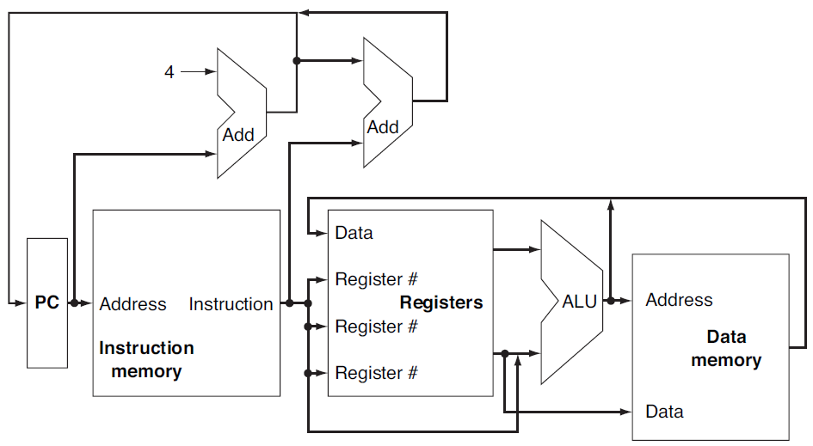
An abstract view of the implementation of the MIPS subset showing the major functional units and the major connections between them

Slide 10
Implementing MIPS: the Fetch/Execute Cycle
High-level abstract view of fetch/execute implementation
use the program counter (PC) to read instruction address
fetch the instruction from memory and increment PC
use fields of the instruction to select registers to read
execute depending on the instruction
repeat…

Slide 11
Overview: Processor Implementation Styles
Single Cycle
perform each instruction in 1 clock cycle
clock cycle must be long enough for slowest instruction; therefore,
disadvantage: only as fast as slowest instruction
Multi-Cycle
break fetch/execute cycle into multiple steps
perform 1 step in each clock cycle
advantage: each instruction uses only as many cycles as it needs
Pipelined
execute each instruction in multiple steps
perform 1 step / instruction in each clock cycle
process multiple instructions in parallel – assembly line

Slide 12
Functional Elements
Two types of functional elements in the hardware:
elements that operate on data (called combinational elements)
elements that contain data (called state or sequential elements)

Slide 13
Combinational Elements
Works as an input ⇒ output function, e.g., ALU
Combinational logic reads input data from one register and writes output data to another, or same, register
read/write happens in a single cycle – combinational element cannot store data from one cycle to a future one
Combinational logic hardware units

Slide 14
State Elements
State elements contain data in internal storage, e.g., registers and memory
All state elements together define the state of the machine
What does this mean? Think of shutting down and starting up again…
Flipflops and latches are 1-bit state elements, equivalently, they are 1-bit memories
The output(s) of a flipflop or latch always depends on the bit value stored, i.e., its state, and can be called 1/0 or high/low or true/false
The input to a flipflop or latch can change its state depending on whether it is clocked or not…

Slide 15
State Elements on the Datapath: Register File
Registers are implemented with arrays of D-flipflops
Clock
5 bits
32 bits
5 bits
5 bits
32 bits
32 bits
Control signal
Register file with two read ports and one write port

Slide 16
State Elements on the Datapath: Register File
Port implementation:
Clock
Clock
Read ports are implemented with a pair of multiplexors – 5 bit multiplexors for 32 registers
Write port is implemented using a decoder – 5-to-32 decoder for 32 registers. Clock is relevant to write as register state may change only at clock edge

Slide 17
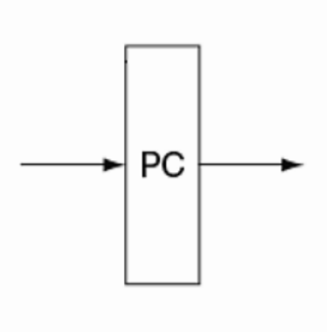
Building a datapath
The PC is a state element that holds the address of the current instruction
A 32-bit register which holds the instruction address and is updated at the end of every clock cycle
Normally PC increments sequentially except for branch instructions
The arrows on either side indicate that the PC state element is both readable and writeable
Address
Address
Program Counter

Slide 18
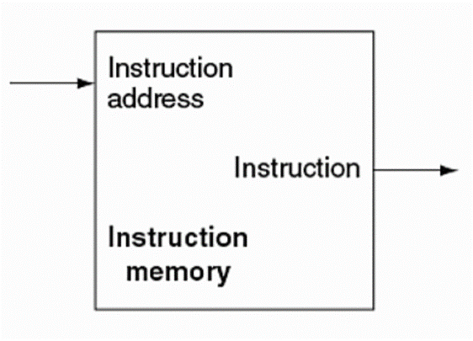
Building a datapath
Instruction memory is a state element that provides read-access to the instructions of a program and, given an address as input, supplies the corresponding instruction at that address
Instruction Memory

Slide 19
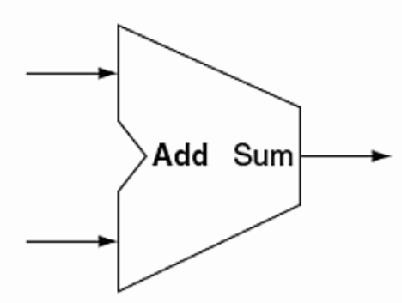
Building a datapath
The adder is responsible for incrementing the PC to hold the address of the next instruction
It takes two input values, adds them together and outputs the result.
Adder

Slide 20
Single-cycle Implementation of MIPS
We first implement MIPS using a single long clock cycle for every instruction
Every instruction begins on one up (or, down) clock edge and ends on the next up (or, down) clock edge
This approach is not practical as it is much slower than a multicycle implementation where different instruction classes can take different numbers of cycles
in a single-cycle implementation every instruction must take the same amount of time as the slowest instruction
in a multicycle implementation this problem is avoided by allowing quicker instructions to use fewer cycles
Even though the single-cycle approach is not practical it is simple and useful to understand first
Note : we shall implement jump at the very end

Slide 21
Datapath: Instruction Store/Fetch & PC Increment
Three elements used to store and fetch instructions and increment the PC
Datapath

Slide 22
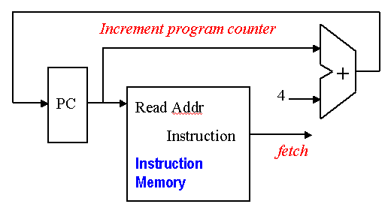
Datapath
Fetch the instruction at the address in PC
Decode the instruction
Execute the instruction
Update the PC to hold the address of the next instruction
Note: we perform PC+4 because MIPS instructions are word-aligned

Slide 23
Animating the Datapath
Instruction <- MEM[PC]
PC <- PC + 4

Slide 24
RECAP: R-Type instructions
6 bits
5 bits
5 bits
5 bits
5 bits
6 bits
op
rs
rt
rd
shamt
funct
31
0
Used for arithmetic, logical, shift instructions
op: Basic operation of the instruction (opcode)
rs: first register source operand
rt: second register source operand
rd: register destination operand
shamt: shift amount
funct: function - specific type of operation
Also called “R-Format” or “R-Type” Instructions

Slide 25
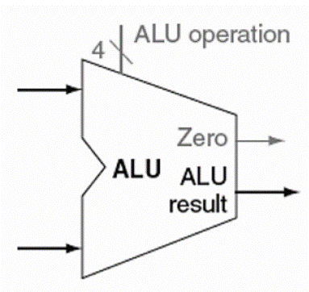
Building a datapath
The ALU performs the operation indicated by the instruction
It takes two operands, as well as a 4-bit wide operation selector value
The result of the operation is the output value
We have an additional output specifically for branching – we will cover this later
32
32
32
ALU

Slide 26
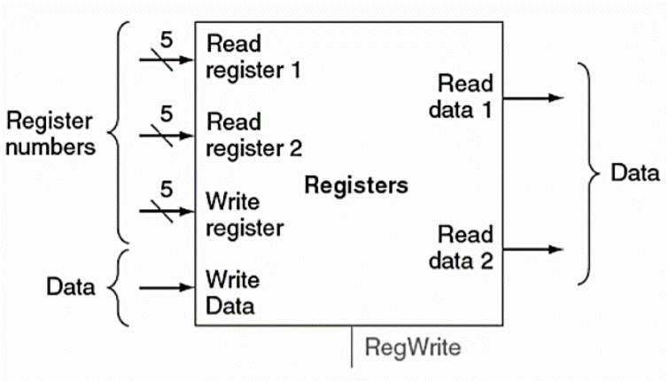
Building a datapath
To support R-format instructions, we’ll need to add a state element called a register file
A register file is a collection readable/writeable registers
Read register 1 – first source register. 5 bits wide
Read register 2 – second source register. 5 bits wide
Write register – destination register. 5 bits wide
Write data – data to be written to a register. 32 bits wide.
Register File

Slide 27
Building a datapath
At the bottom, we have the RegWrite input
A writing operation only occurs when this bit is set
The two output ports are:
Read data 1 – contents of source register 1
Read data 2 – contents of source register 2
Register File

Slide 28
Datapath: R-Type Instruction
Two elements used to implement
R-type instructions
Datapath

Slide 29
Animating the Datapath
add rd, rs, rt
R[rd] <- R[rs] + R[rt];

Slide 30
RECAP: I-type instructions
6 bits
5 bits
5 bits
16 bits
op
rs
rt
offset
Used for load, store instructions
op: Basic operation of the instruction (opcode)
rs: first register source operand
rt: second register source operand
offset: 16-bit signed address offset (-32,768 to +32,767)
Also called “I-Format” or “I-Type” instructions
Address

Slide 31
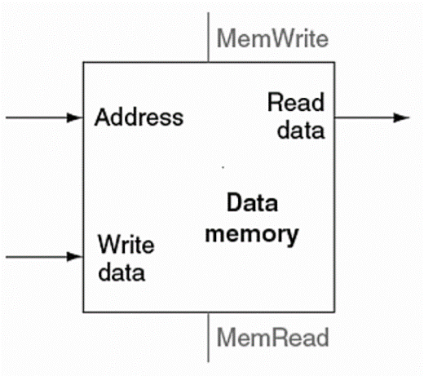
Building a datapath
The data memory element implements the functionality for reading and writing data to/from memory
There are two inputs. One for the address of the memory location to access, the other for the data to be written to memory if applicable.
The output is the data read from the memory location accessed, if applicable
Reads and writes are signaled by MemRead and MemWrite, respectively, which must be asserted for the corresponding action to take place
Data Memory

Slide 32
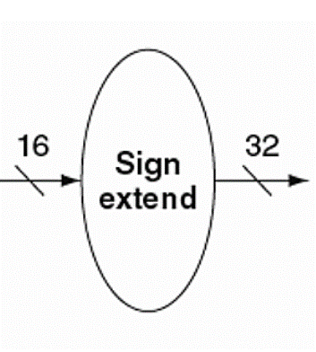
Building a datapath
To perform sign-extending, we can add a sign extension element
The sign extension element takes as input a 16-bit wide value to be extended to 32-bits
To sign extend, we simply replicate the most-significant bit of the original field until we have reached the desired field width
Sign extension unit

Slide 33
Datapath: Load/Store Instruction
Two additional elements used
To implement load/stores
Datapath

Slide 34
Animating the Datapath
lw rt, offset(rs)
R[rt] <- MEM[R[rs] + s_extend(offset)];

Slide 35
Animating the Datapath
sw rt, offset(rs)
MEM[R[rs] + sign_extend(offset)] <- R[rt]

Slide 36
Datapath: Branch Instruction
No shift hardware required:
simply connect wires from
input to output, each shifted
left 2 bits
Datapath

Slide 37
Animating the Datapath
beq rs, rt, offset
if (R[rs] == R[rt]) then PC <- PC+4 + s_extend(offset<<2)

Slide 38
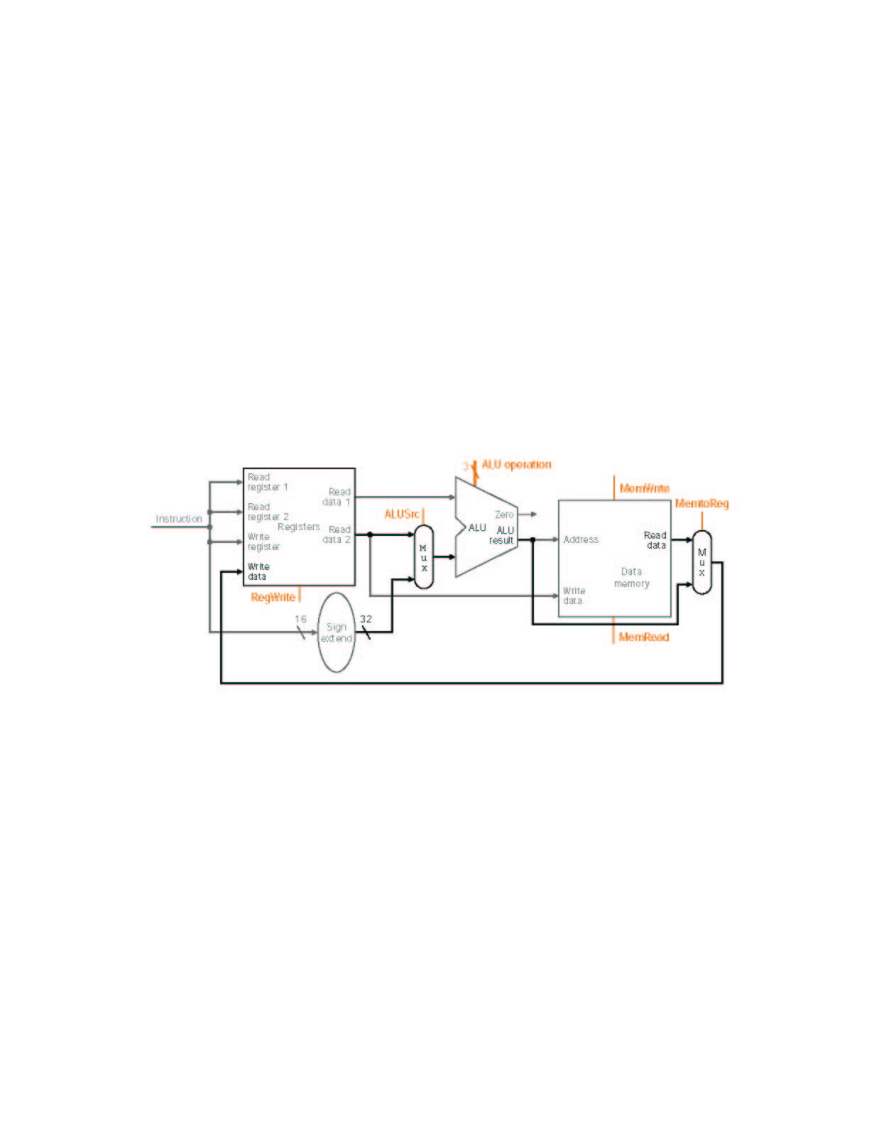
MIPS Datapath I: Single-Cycle
Input is either register (R-type) or sign-extended
lower half of instruction (load/store)
Data is either
from ALU (R-type)
or memory (load)
Combining the datapaths for R-type instructions
and load/stores using two multiplexors

Slide 39
Animating the Datapath: R-type Instruction
add rd,rs,rt

Slide 40
Animating the Datapath: Load Instruction
lw rt,offset(rs)

Slide 41
Animating the Datapath: Store Instruction
sw rt,offset(rs)

Slide 42
MIPS Datapath II: Single-Cycle
Separate adder as ALU operations and PC
increment occur in the same clock cycle
Separate instruction memory
as instruction and data read
occur in the same clock cycle
Adding instruction fetch

Slide 43
MIPS Datapath III: Single-Cycle Versatile Datapath
New multiplexor
Extra adder needed as both
adders operate in each cycle
Instruction address is either
PC+4 or branch target address
Adding branch capability and another multiplexor
Important note: in a single-cycle implementation data cannot be stored
during an instruction – it only moves through combinational logic
Question: is the MemRead signal really needed?! Think of RegWrite…!

Slide 44
Datapath Executing add
add rd, rs, rt

Slide 45
Datapath Executing lw
lw rt,offset(rs)

Slide 46
Datapath Executing sw
sw rt,offset(rs)

Slide 47
Datapath Executing beq
beq r1,r2,offset

Slide 48
Control
Now we have a complete datapath for our simple MIPS subset – we will show the whole diagram in just a couple of minutes. Before that, we will add the control.
The control unit is responsible for taking the instruction and generating the appropriate signals for the datapath elements
Signals that need to be generated include
Operation to be performed by ALU.
Whether register file needs to be written.
Signals for multiple intermediate multiplexors.
Whether data memory needs to be written.
For the most part, we can generate these signals using only the opcode and funct fields of an instruction

Slide 49
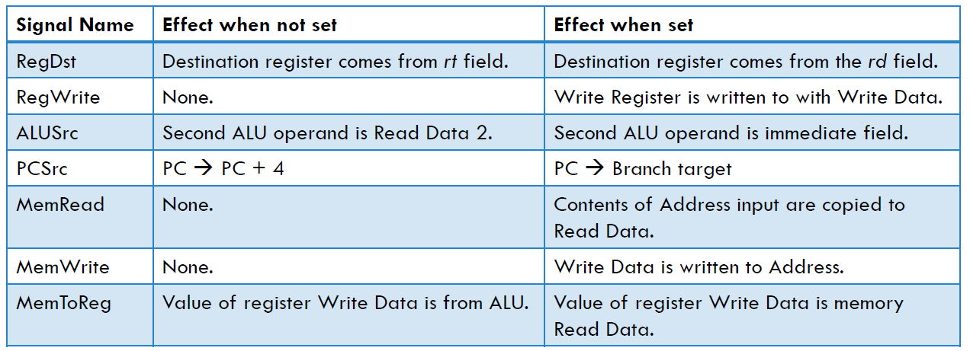
Control signals

Slide 50
Office Hours
Monday 1120-1210 @ My office

Slide 51
RECAP: J-Type Instructions
J instructions have the following machine-code format:
opcode | Pseudo-Address
6 bits | 26 bits
Opcode
The 6 bit opcode corresponding to the particular jump command. (26 to 31)
Address
A 26-bit shortened address of the destination. (0 to 25)
The two least significant bits are removed, and the 4 most significant bits are removed, and assumed to be the same as the current instruction's address

Slide 52
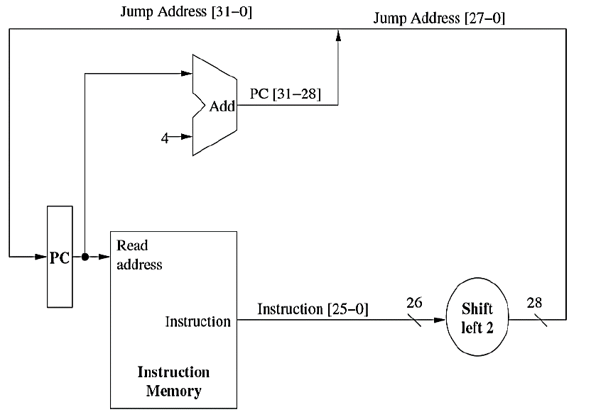
Datapath for J format
j targetaddress

Slide 53
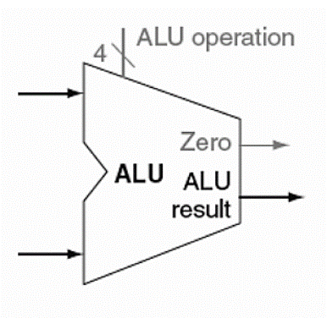
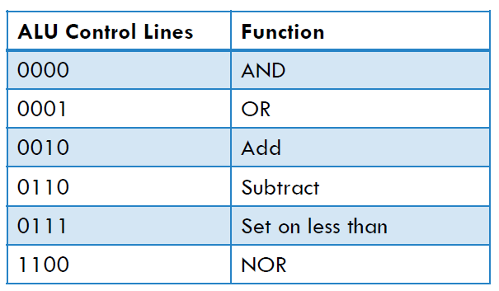
ALU Control Lines
Note here that the ALU has a 4-bit control line called ALU operation
The first two bits indicate whether a and b need to be inverted, respectively.
The last two bits indicate the operation

Slide 54
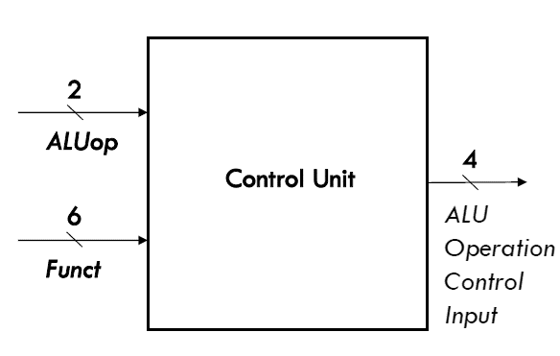
ALU Control Lines
How do we set these control lines? Consider the control unit below.
The 2-bit ALUop input indicates whether an operation should be add (00) for loads and stores, subtract (01) for beq, or determined by the funct input (10)
Case 00 and 01 are determined by the op field
Case 10 is used by R-format instructions
The 6-bit Funct input corresponds to the funct field of R-format instructions. Each unique funct field corresponds to a unique set of ALU control input lines

Slide 55
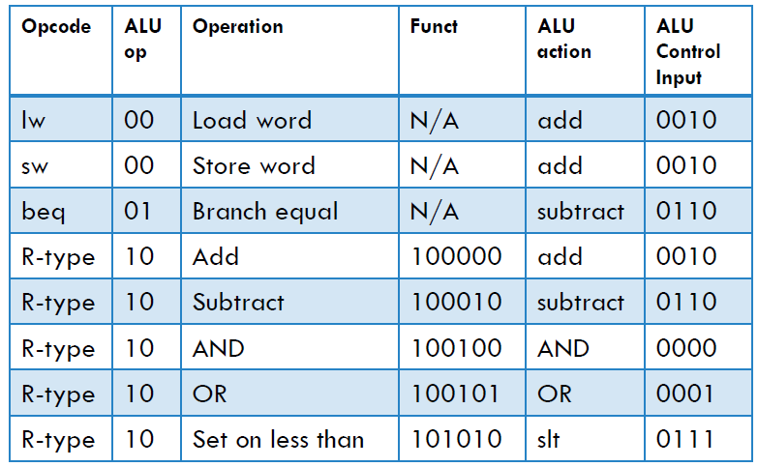
ALU Control Lines

Slide 56
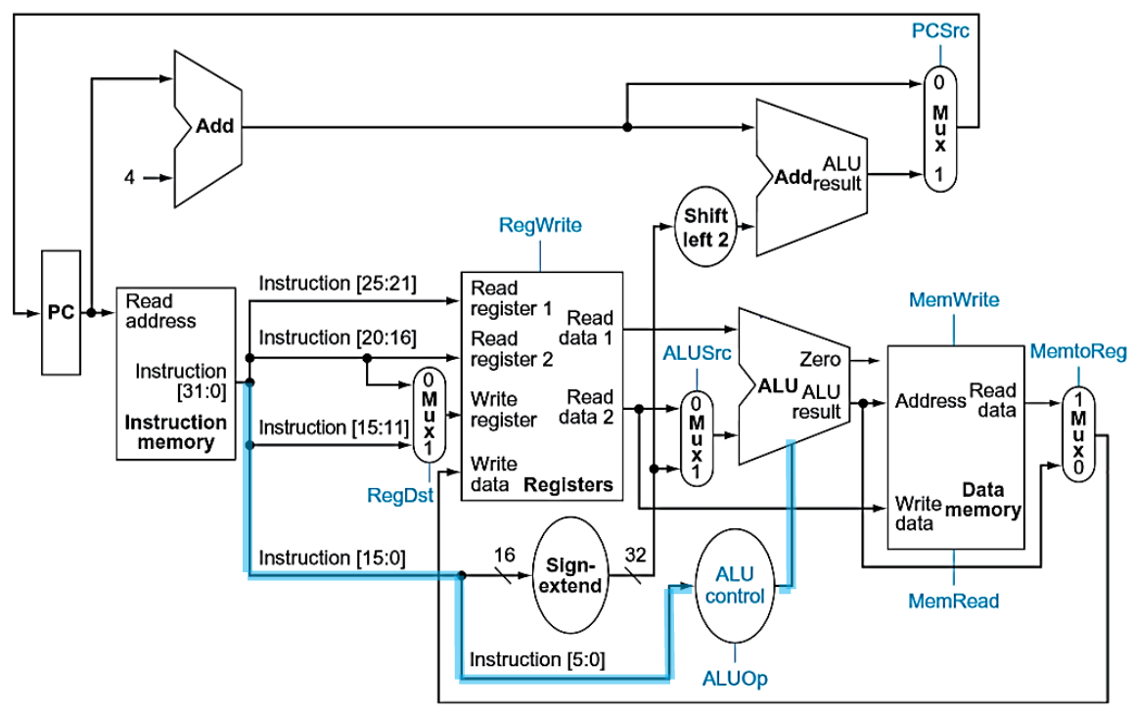

Slide 57
Datapath with Control II
MIPS datapath with the control unit: input to control is the 6-bit instruction
opcode field, output is seven 1-bit signals and the 2-bit ALUOp signal

Slide 58
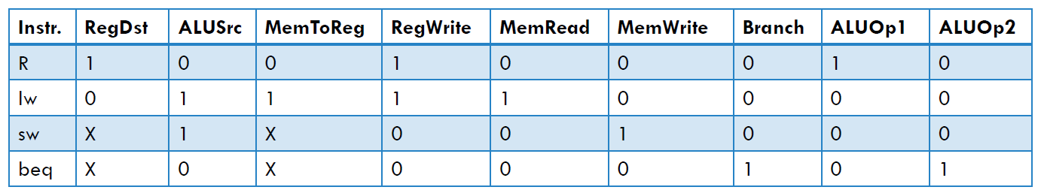
Control signals
From the previous slide, we can see that the control signals are chosen based on the upper 6 bits of the instruction. That is, the opcode is used to set the control lines
Furthermore, as we saw before, the ALU control input lines are also dictated by the funct fields of applicable instructions.

Slide 59
Datapath with Control II (cont.)
PCSrc cannot be
set directly from the
opcode: zero test
outcome is required
Determining control signals for the MIPS datapath based on instruction opcode

Slide 60
Control Signals: R-Type Instruction
0
???
Value depends on funct
1
0
0
1
Control signals
shown in blue
0
0

Slide 61
Control Signals: lw Instruction
0
010
0
0
1
1
Control signals
shown in blue
1
1

Slide 62
Control Signals: sw Instruction
0
010
X
1
X
0
Control signals
shown in blue
1
0

Slide 63
Control Signals: beq Instruction
1 if Zero=1
110
X
0
X
0
Control signals
shown in blue
0
0

Slide 64
Datapath with Control III
Jump
opcode
address
31-26
Composing jump
target address
25-0
New multiplexor with additional
control bit Jump
MIPS datapath extended to jumps: control unit generates new Jump control bit

Slide 65
Datapath Executing j

Slide 66
R-type Instruction: Step 1 add $t1, $t2, $t3 (active = bold)
Fetch instruction and increment PC count

Slide 67
R-type Instruction: Step 2 add $t1, $t2, $t3 (active = bold)
Read two source registers from the register file

Slide 68
R-type Instruction: Step 3 add $t1, $t2, $t3 (active = bold)
ALU operates on the two register operands

Slide 69
R-type Instruction: Step 4 add $t1, $t2, $t3 (active = bold)
Write result to register

Slide 70
Load Instruction Steps lw $t1, offset($t2)
Fetch instruction and increment PC
Read base register from the register file: the base register ($t2) is given by bits 25-21 of the instruction
ALU computes sum of value read from the register file and the sign-extended lower 16 bits (offset) of the instruction
The sum from the ALU is used as the address for the data memory
The data from the memory unit is written into the register file: the destination register ($t1) is given by bits 20-16 of the instruction

Slide 71
Load Instruction lw $t1, offset($t2)

Slide 72
Branch Instruction Steps beq $t1, $t2, offset
Fetch instruction and increment PC
Read two register ($t1 and $t2) from the register file
ALU performs a subtract on the data values from the register file; the value of PC+4 is added to the sign-extended lower 16 bits (offset) of the instruction shifted left by two to give the branch target address
The Zero result from the ALU is used to decide which adder result (from step 1 or 3) to store in the PC

Slide 73
Branch Instruction beq $t1, $t2, offset

Slide 74
Single-cycle Implementation Notes
The advantage of single cycle implementation is that it is simple to implement.
Disadvantages
The clock cycle will be determined by the longest possible path, which is not the most common instruction. This type of implementation violates the idea of making the common case fast.
May be wasteful with respect to area since some functional units, such as adders, must be duplicated since they cannot be shared during a single clock cycle

